Slide 1
Chapter 8: Single-Area OSPF
Routing & Switching
Notes:
Cisco Networking Academy program
Routing Protocols
Chapter 8

Slide 2
Chapter 8
8.1 Characteristics of OSPF
8.2 Configuring Single-area OSPFv2
8.3 Configure Single-area OSPFv3
Notes:
Chapter 8

Slide 3
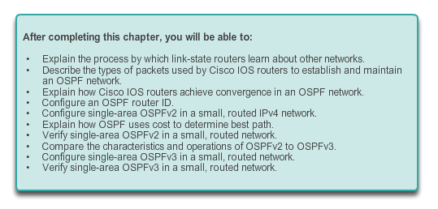
Chapter 8: Objectives

Slide 4
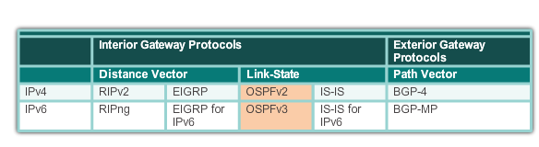
Open Shortest Path First Evolution of OSPF
Interior Gateway Protocols
1989
updated in 2008
1988
Notes:
8.1.1.1 Evolution of OSPF

Slide 5
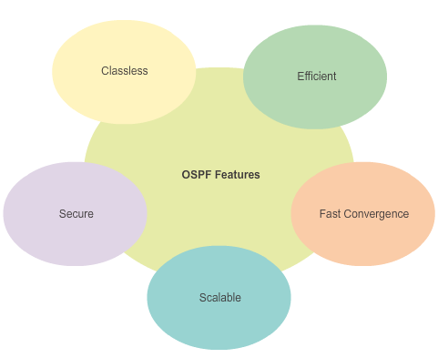
Open Shortest Path First Features of OSPF
Notes:
8.1.1.2 Features of OSPF

Slide 6
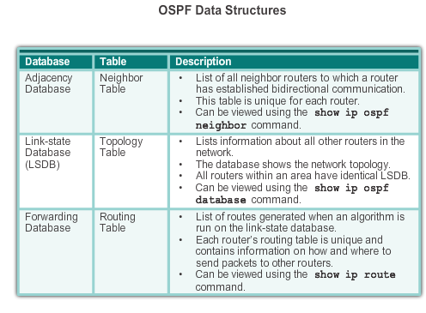
Open Shortest Path First Components of OSPF
Notes:
8.1.1.3 Components of OSPF

Slide 7
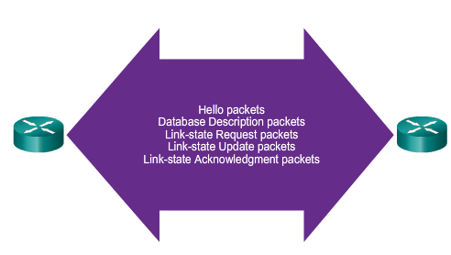
Open Shortest Path First Components of OSPF (cont.)
OSPF Routers Exchange Packets - These packets are used to discover neighboring routers and also to exchange routing information to maintain accurate information about the network.
Notes:
8.1.1.3 Components of OSPF (cont.)

Slide 8
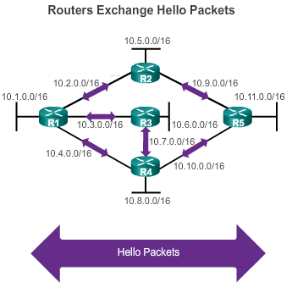
Open Shortest Path First Link-State Operation
If a neighbor is present, the OSPF-enabled router attempts to establish a neighbor adjacency with that neighbor
Notes:
8.1.1.4 Link-State Operation

Slide 9
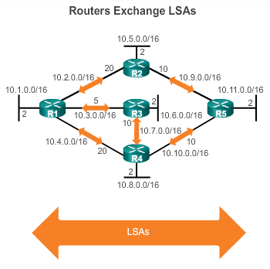
Open Shortest Path First Link-State Operation (cont.)
LSAs contain the state and cost of each directly connected link.
Routers flood their LSAs to adjacent neighbors.
Adjacent neighbors receiving the LSA immediately flood the LSA to other directly connected neighbors, until all routers in the area have all LSAs.
Notes:
8.1.1.4 Link-State Operation (cont.)

Slide 10
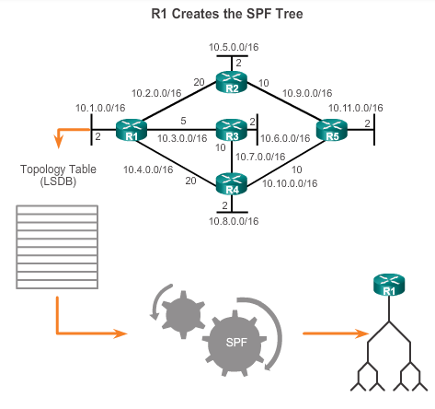
Open Shortest Path First Link-State Operation
Build the topology table based on the received LSAs.
This database eventually holds all the information about the topology of the network.
Execute the SPF Algorithm.
Notes:
8.1.1.4 Link-State Operation (cont.)

Slide 11
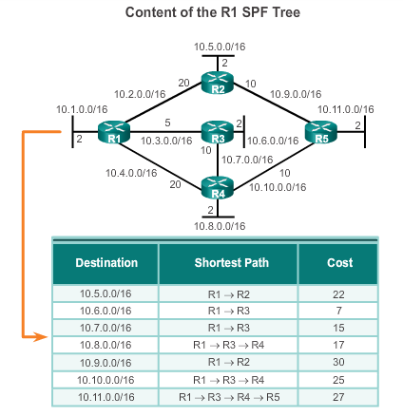
Open Shortest Path First Link-State Operation (cont.)
From the SPF tree, the best paths are inserted into the routing table.
Notes:
8.1.1.4 Link-State Operation (cont.)

Slide 12
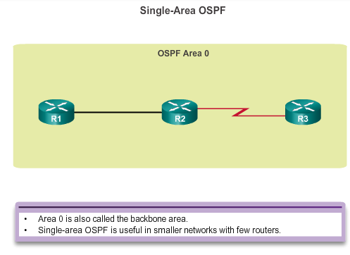
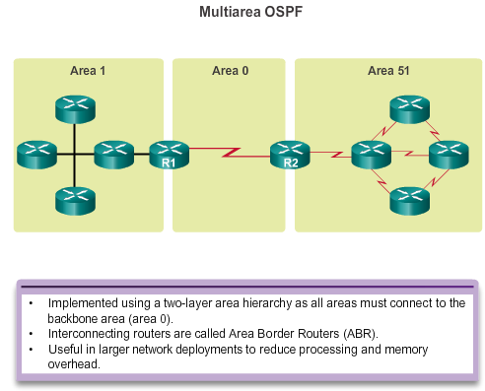
Open Shortest Path First Single-area and Multiarea OSPF
Notes:
8.1.1.5 Single-Area and Multiarea OSPF

Slide 13
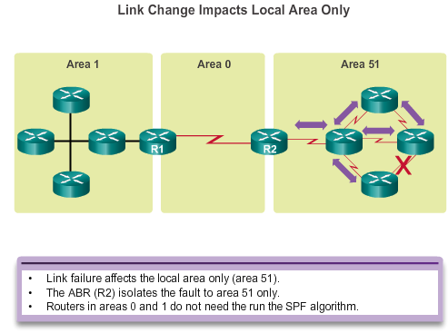
Open Shortest Path First Single-area and Multiarea OSPF (cont.)
Notes:
8.1.1.5 Single-Area and Multiarea OSPF (cont.)

Slide 14
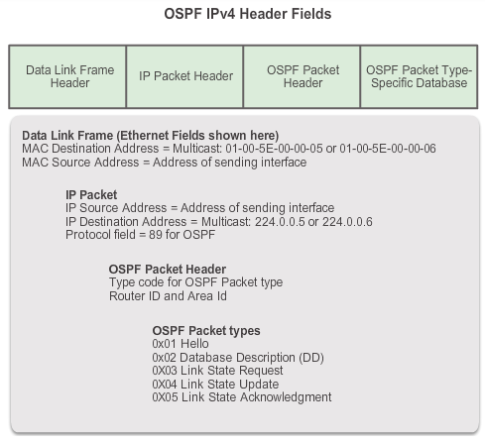
OSPF Messages Encapsulating OSPF Messages
Notes:
8.1.2.1 Encapsulating OSPF Messages

Slide 15
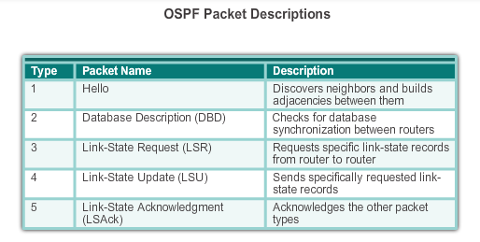
OSPF Messages Types of OSPF Packets
Notes:
8.1.2.2 Types of OSPF Packets

Slide 16
OSPF Messages Hello Packet
OSPF Type 1 packet = Hello packet:
Discover OSPF neighbors and establish neighbor adjacencies.
Advertise parameters on which two routers must agree to become neighbors.
Elect the Designated Router (DR) and Backup Designated Router (BDR) on multiaccess networks like Ethernet and Frame Relay.
Notes:
8.1.2.3 Hello Packet

Slide 17
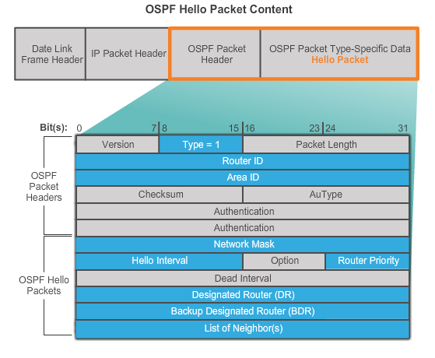
OSPF Messages Hello Packet (cont.)
Notes:
8.1.2.3 Hello Packet (cont.)

Slide 18
OSPF Messages Hello Packet Intervals
OSPF Hello packets are transmitted:
To 224.0.0.5 in IPv4 and FF02::5 in IPv6 (all OSPF routers)
Every 10 seconds (default on multiaccess and point-to-point networks)
Every 30 seconds (default on non-broadcast multiaccess [NBMA] networks)
Dead interval is the period that the router waits to receive a Hello packet before declaring the neighbor down
Router floods the LSDB with information about down neighbors out all OSPF enabled interfaces
Cisco’s default is 4 times the Hello interval
Notes:
8.1.2.4 Hello Packet Intervals (cont.)

Slide 19
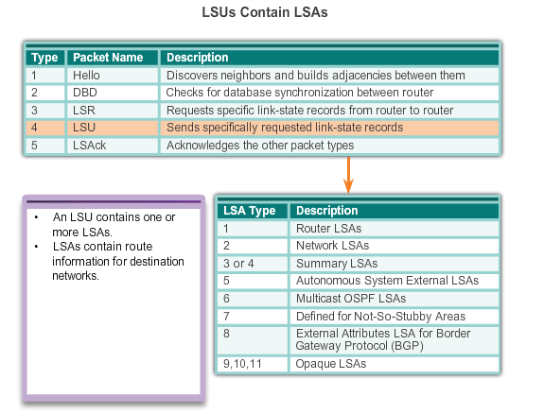
OSPF Messages Link-State Updates
Notes:
8.1.2.5 Link-State Updates

Slide 20
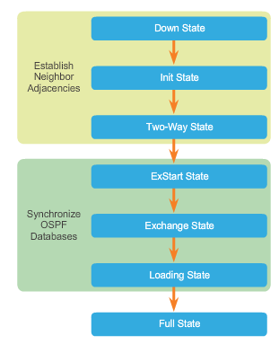
OSPF Operation OSPF Operational States
When an OSPF router is initially connected to a network, it attempts to:
Create adjacencies with neighbors
Exchange routing information
Calculate the best routes
Reach convergence
OSPF progresses through several states while attempting to reach convergence.
Notes:
8.1.3.1 OSPF Operational States

Slide 21
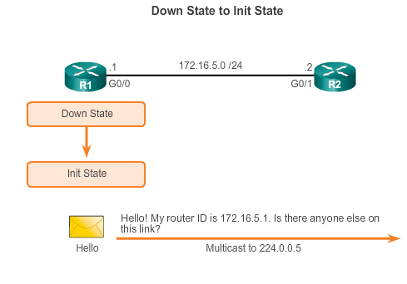
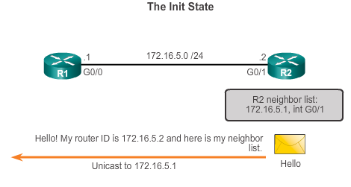
OSPF Operation Establish Neighbor Adjacencies
Notes:
8.1.3.2 Establish Neighbor Adjacencies

Slide 22
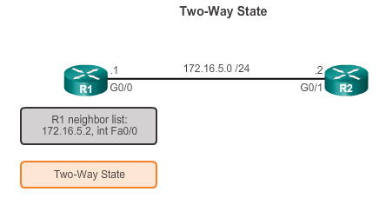
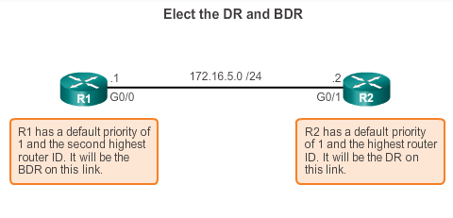
OSPF Operation Establish Neighbor Adjacencies (cont.)
DR and BDR election only occurs on multi-access networks such as Ethernet LANs.
Notes:
8.1.3.2 Establish Neighbor Adjacencies (cont.)

Slide 23
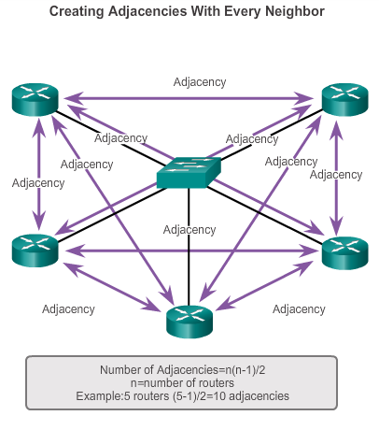
OSPF Operation OSPF DR and BDR
Notes:
8.1.3.3 OSPF DR and BDR

Slide 24
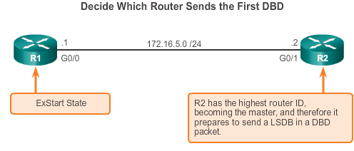
OSPF Operation Synchronizing OSPF Database
Notes:
8.1.3.4 Synchronizing OSPF Databases

Slide 25
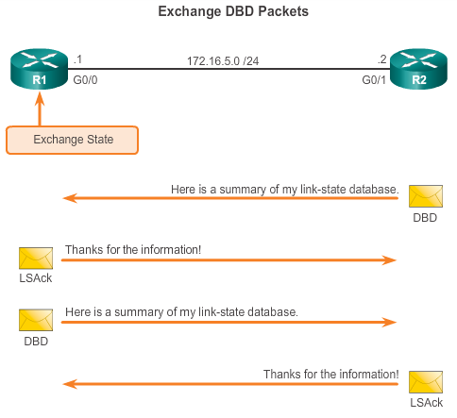
OSPF Operation Synchronizing OSPF Database (cont.)
Notes:
8.1.3.4 Synchronizing OSPF Databases

Slide 26
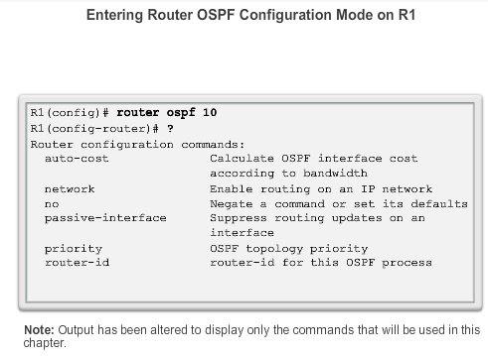
OSPF Router ID OSPF Network Topology
Notes:
8.2.1.2 Router OSPF Configuration Mode

Slide 27
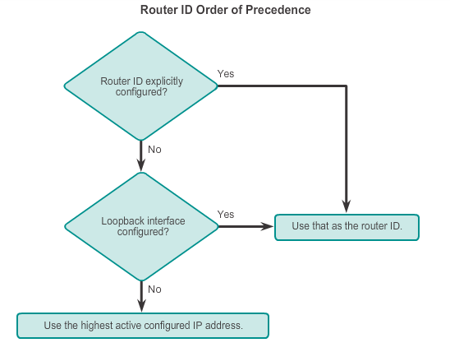
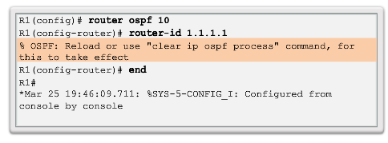
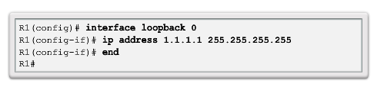
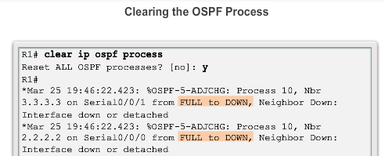
OSPF Router ID Router IDs
Notes:
8.2.1.3 Router IDs
8.2.1.4 Configuring an OSPF Router ID
8.2.1.5 Modifying a Router ID
8.2.1.6 Using a Loopback Interface as the Router ID

Slide 28
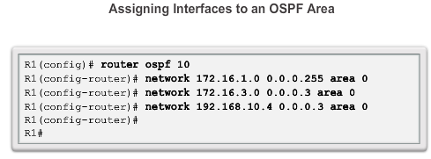
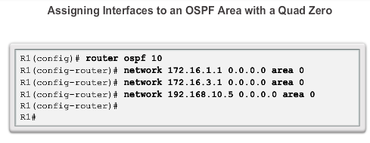
Configure Single-area OSPFv2 The network Command
Notes:
8.2.2.1 Enabling OSPF on Interfaces
8.2.2.2 Wildcard Mask
8.2.2.3 The network Command

Slide 29
Configure Single-Area OSPFv2 Passive Interface
By default, OSPF messages are forwarded out all OSPF-enabled interfaces. However, these messages really only need to be sent out interfaces connecting to other OSPF-enabled routers.
Sending out unneeded messages on a LAN affects the network in three ways:
Inefficient Use of Bandwidth
Inefficient Use of Resources
Increased Security Risk
The Passive Interface feature helps limiting the scope of routing updates advertisements.
Notes:
8.2.2.4 Passive Interface

Slide 30
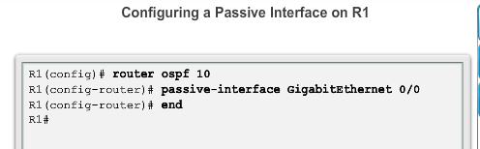
Configure Single-area OSPFv2 Configuring Passive Interfaces
Use the passive-interface router configuration mode command to prevent the transmission of routing messages through a router interface, but still allow that network to be advertised to other routers.
Notes:
8.2.2.5 Configuring Passive Interfaces

Slide 31
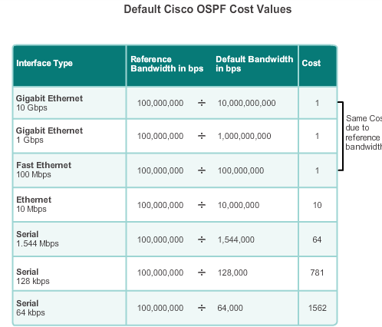
OSPF Cost OSPF Metric = Cost
Cost = reference bandwidth / interface bandwidth
(default reference bandwidth is 10^8)
Cost = 100,000,000 bps / interface bandwidth in bps
Notes:
8.2.3.1 OSPF Metric = Cost

Slide 32
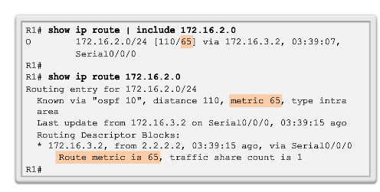
OSPF Cost OSPF Accumulates Costs
Cost of an OSPF route is the accumulated value from one router to the destination network.
Notes:
8.2.3.2 OSPF Accumulates Costs

Slide 33
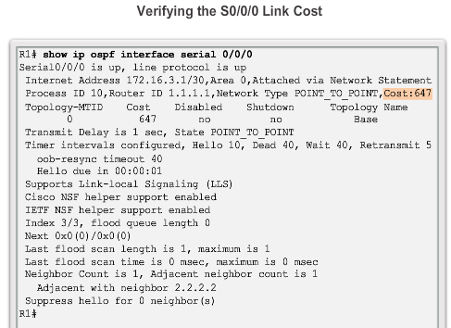
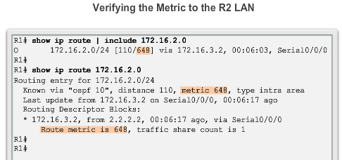
OSPF Cost Adjusting the Reference Bandwidth
Use the command - auto-cost reference-bandwidth
Must be configured on every router in the OSPF domain
Notice that the value is expressed in Mb/s:
Gigabit Ethernet - auto-cost reference-bandwidth 1000
10 Gigabit Ethernet - auto-cost reference-bandwidth 10000
Notes:
8.2.3.3 Adjusting the Reference Bandwidth

Slide 34
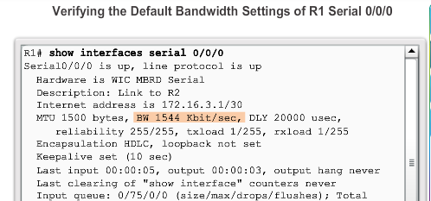
OSPF Cost Default Interface Bandwidths
On Cisco routers, the default bandwidth on most serial interfaces is set to 1.544 Mb/s.
Notes:
8.2.3.4 Default Interface Bandwidths

Slide 35
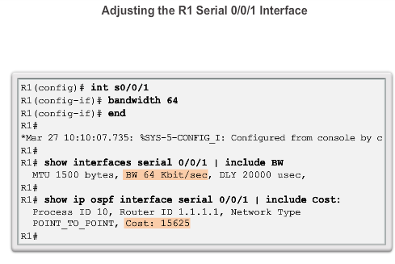
OSPF Cost Adjusting the Interface Bandwidths
Notes:
8.2.3.5 Adjusting the Interface Bandwidths

Slide 36
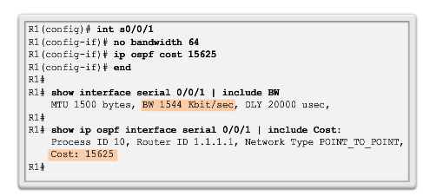
OSPF Cost Manually Setting the OSPF Cost
Both the bandwidth interface command and the ip ospf cost interface command achieve the same result, which is to provide an accurate value for use by OSPF in determining the best route.
Notes:
8.2.3.6 Manually Setting the OSPF Cost

Slide 37
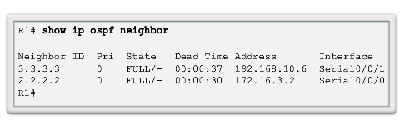
Verify OSPF Verify OSPF Neighbors
Verify that the router has formed an adjacency with its neighboring routers.
Notes:
8.2.4.1 Verify OSPF Neighbors

Slide 38
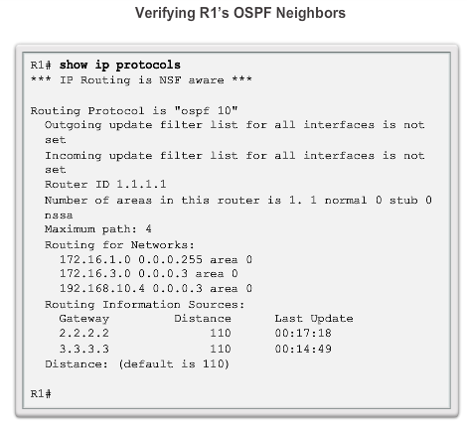
Verify OSPF Verify OSPF Protocol Settings
Notes:
8.2.4.2 Verify OSPF Protocol Settings

Slide 39
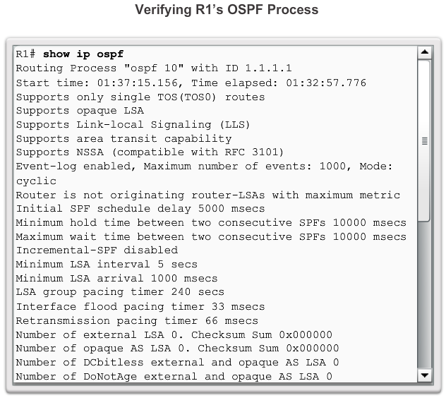
Verify OSPF Verify OSPF Process Information
Notes:
8.2.4.3 Verify OSPF Process Information

Slide 40
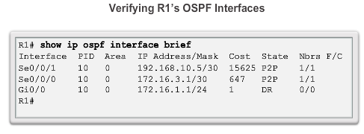
Verify OSPF Verify OSPF Interface Settings
Notes:
8.2.4.4 Verify OSPF Interface Settings

Slide 41
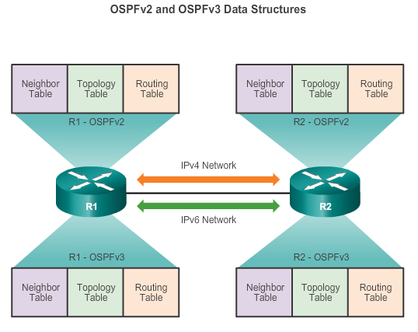
OSPFv2 vs. OSPFv3 OSPFv3
Notes:
8.3.1.1 OSPFv3

Slide 42
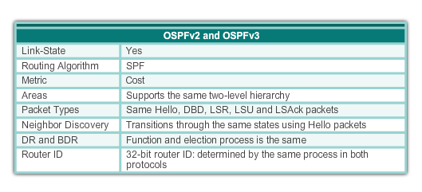
OSPFv2 vs. OSPFv3 Similarities Between OSPFv2 to OSPFv3
Notes:
8.3.1.2 Similarities Between OSPFv2 to OSPFv3

Slide 43
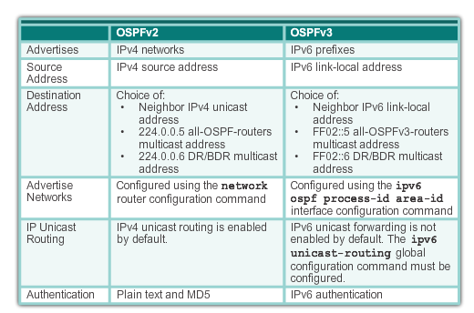
OSPFv2 vs. OSPFv3 Differences Between OSPFv2 to OSPFv3
Notes:
8.3.1.3 Differences Between OSPFv2 and OSPFv3

Slide 44
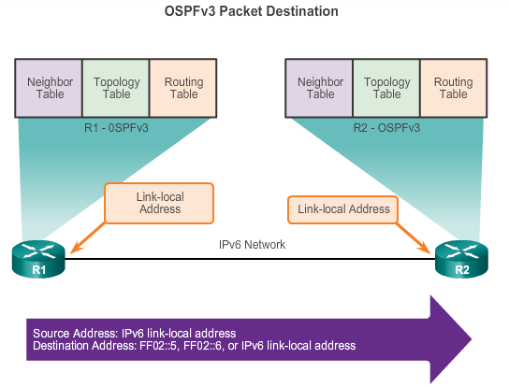
OSPFv2 vs. OSPFv3 Link-Local Addresses
FF02::5 address is the all OSPF router address
FF02::6 is the DR/BDR multicast address
Notes:
8.3.1.4 Link-Local Addresses

Slide 45
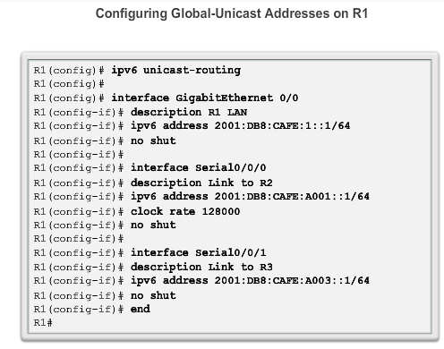
Configuring OSFPv3 OSPFv3 Network Topology
Notes:
8.3.2.1 OSPFv3 Network Topology

Slide 46
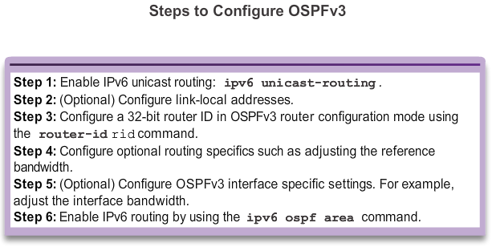
Configuring OSFPv3 OSPFv3 Network Topology (cont.)
Notes:
8.3.2.1 OSPFv3 Network Topology

Slide 47
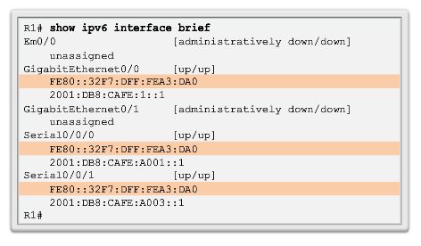
Configuring OSFPv3 Link-Local Addresses
Link-local addresses are automatically created when an IPv6 global unicast address is assigned to the interface (required).
Global unicast addresses are not required.
Cisco routers create the link-local address using FE80::/10 prefix and the EUI-64 process unless the router is configured manually,
EUI-64 involves using the 48-bit Ethernet MAC address, inserting FFFE in the middle and flipping the seventh bit. For serial interfaces, Cisco uses the MAC address of an Ethernet interface.
Notice in the figure that all three interfaces are using the same link-local address.
Notes:
8.3.2.2 Link-Local Addresses

Slide 48


Configuring OSFPv3 Assigning Link-Local Addresses
Manually configuring the link-local address provides the ability to create an address that is recognizable and easier to remember.
Notes:
8.3.2.3 Assigning Link-Local Addresses

Slide 49

Configuring OSFPv3 Configuring the OSPFv3 Router ID
Notes:
8.3.2.4 Configuring the OSPFv3 Router ID

Slide 50

Configuring OSFPv3 Configuring the OSPFv3 Router ID (cont.)
Notes:
8.3.2.4 Configuring the OSPFv3 Router ID (cont.)

Slide 51


Configuring OSFPv3 Modifying an OSPFv3 Router ID
Notes:
8.3.2.5 Modifying an OSPFv3 Router ID

Slide 52

OSPF Configuring OSFPv3 Enabling OSPFv3 on Interfaces
Instead of using the network router configuration mode command to specify matching interface addresses, OSPFv3 is configured directly on the interface.
Notes:
8.3.2.6 Enabling OSPFv3 on Interfaces

Slide 53


Verify OSPFv3 Verify OSPFv3 Neighbors/Protocol Settings
Notes:
8.3.3.1 Verify OSPFv3 Neighbors
8.3.3.2 Verify OSPFv3 Protocol Settings

Slide 54

Verify OSPFv3 Verify OSPFv3 Interfaces
Notes:
8.3.3.3 Verify OSPFv3 Interfaces

Slide 55

Verify OSPFv3 Verify IPv6 Routing Table
Notes:
8.3.3.4 Verify the IPv6 Routing Table

Slide 56
Chapter 8: Summary
OSPF:
For IPv4 is OSPFv2
For IPv6 is OSPFv3
Classless, link-state routing protocol with a default administrative distance of 110, and is denoted in the routing table with a route source code of O
OSPFv2 is enabled with the router ospf process-id global configuration mode command. The process-id value is locally significant, which means that it does not need to match other OSPF routers to establish adjacencies with those neighbors.
Network command uses the wildcard-mask value which is the inverse of the subnet mask, and the area-id value
Notes:
Chapter 8 Summary

Slide 57
Chapter 8: Summary (cont.)
OSPF:
By default, OSPF Hello packets are sent every 10 seconds on multiaccess and point-to-point segments and every 30 seconds on NBMA segments (Frame Relay, X.25, ATM), and are used by OSPF to establish neighbor adjacencies. The Dead interval is four times the Hello interval, by default.
For routers to become adjacent, their Hello interval, Dead interval, network types, and subnet masks must match. Use the show ip ospf neighborscommand to verify OSPF adjacencies.
In a multiaccess network, OSPF elects a DR to act as collection and distribution point for LSAs sent and received. A BDR is elected to assume the role of the DR should the DR fail. All other routers are known as DROTHERs. All routers send their LSAs to the DR, which then floods the LSA to all other routers in the multiaccess network.
Notes:
Chapter 8 Summary

Slide 58
Chapter 8: Summary (cont.)
OSPF:
In multiaccess networks, the router with the highest router ID is the DR, and the router with the second highest router ID is the BDR. This can be superseded by the ip ospf priority command on that interface. The router with the highest priority value is the DR, and next-highest the BDR.
The show ip protocols command is used to verify important OSPF configuration information, including the OSPF process ID, the router ID, and the networks the router is advertising.
OSPFv3 is enabled on an interface and not under router configuration mode. OSPFv3 needs link-local addresses to be configured. IPv6 Unicast routing must be enabled for OSPFv3. A 32-bit router-ID is required before an interface can be enabled for OSPFv3.
Notes:
Chapter 8 Summary

Slide 59
Chapter 8: Summary (cont.)
OSPF:
The show ip protocols command is used to verify important OSPFv2 configuration information, including the OSPF process ID, the router ID, and the networks the router is advertising.
OSPFv3
Enabled on an interface and not under router configuration mode
Needs link-local addresses to be configured. IPv6
Unicast routing must be enabled for OSPFv3
32-bit router-ID is required before an interface can be enabled for OSPFv3
show ipv6 protocols command is a quick way to verify configuration information (OSPF process ID, the router ID, and the interfaces enabled for OSPFv3)
Notes:
Chapter 8 Summary

Slide 60


